Slide 1
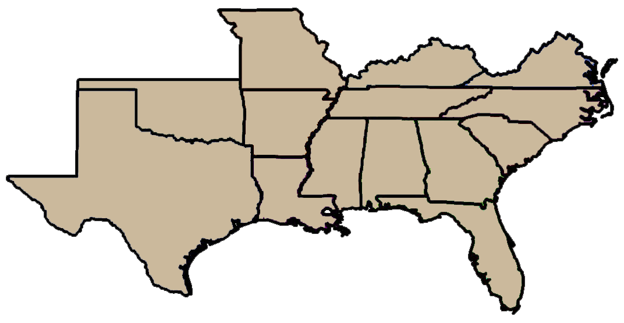
Show Me the Money!
Lee Van Wychen
Executive Director of Science Policy
The National and Regional Weed Science Societies
Southern Weed Science Society
North Central
Weed Science Society

Slide 2
Outline
Show Me the Money? Review of Federal Agency spending on invasive species activities
117th Congress: House and Senate Appropriations Committees that fund invasive species activities
Jurisdiction, Leaders, and Members
Agriculture, Rural Development, FDA & Related ““
Commerce, Justice, and Science (CJS) & Related “”
Energy and Water Development, & Related “”
Interior, Environment & Related Agencies
Some Advocacy Tips

Slide 3
FY 2020 Funding for Invasive Species Activities
 | USDA | DHS
 | --- $ millions ---
Prevention | 102.4 | 1,158
EDRR | 321.8 | -
Control and Management | 543.6 | -
Research | 413.5 | -
Restoration | 34.9 | -
Ed. and Public Awareness | 55.3 | -
Leadership/Int’l Cooperation | 2.5 | -
TOTAL | 1,474 | 1,158
Department of Agriculture (USDA): Agricultural Research Service (ARS), Animal and Plant Health Inspection Service (APHIS), Economic Research Service (ERS), National Institute of Food and Agriculture (NIFA), Natural Resources Conservation Service (NRCS), Office of the Chief Economist, U.S. Forest Service (USFS).
Department of Homeland Security (DHS): Customs and Border Protection (CBP), U.S. Coast Guard
Notes:
The Senate Committee on Appropriations released all twelve fiscal year (FY) 2021 appropriation bills on November 10, 2020. The bills will forego Committee mark ups and debate within the Senate and instead serve as a starting point for bicameral negotiations on an omnibus spending agreement. The House passed ten out of twelve appropriation bills earlier this summer.

Slide 4
FY 2020 Funding for Invasive Species Activities
 | USDA | DHS | DOD
 | -------------------------- $ millions --------------------------
Prevention | 102.4 | 1,158 | 36.4
EDRR | 321.8 | - | 34.3
Control and Management | 543.6 | - | 66.7
Research | 413.5 | - | 9.8
Restoration | 34.9 | - | 9.5
Ed. and Public Awareness | 55.3 | - | 6.6
Leadership/Int’l Cooperation | 2.5 | - | 1.4
TOTAL | 1,474 | 1,158 | 165
Department of Defense (DOD): U.S. Army Corps of Engineers (ACOE)
Notes:
The Senate Committee on Appropriations released all twelve fiscal year (FY) 2021 appropriation bills on November 10, 2020. The bills will forego Committee mark ups and debate within the Senate and instead serve as a starting point for bicameral negotiations on an omnibus spending agreement. The House passed ten out of twelve appropriation bills earlier this summer.

Slide 5
FY 2020 Funding for Invasive Species Activities
 | USDA | DHS | DOD | DOI
 | -------------------------- $ millions --------------------------
Prevention | 102.4 | 1,158 | 36.4 | 15.3
EDRR | 321.8 | - | 34.3 | 25.1
Control and Management | 543.6 | - | 66.7 | 73.1
Research | 413.5 | - | 9.8 | 21.4
Restoration | 34.9 | - | 9.5 | 5.8
Ed. and Public Awareness | 55.3 | - | 6.6 | 0.6
Leadership/Int’l Cooperation | 2.5 | - | 1.4 | 0.7
TOTAL | 1,474 | 1,158 | 165 | 142
Department of the Interior (DOI): Bureau of Indian Affairs (BIA), Bureau of Land Management (BLM), Bureau of Reclamation (BOR), National Park Service (NPS), Office of Insular Affairs, Office of the Secretary, U.S. Fish and Wildlife Service (FWS), U.S. Geological Survey (USGS)
Notes:
The Senate Committee on Appropriations released all twelve fiscal year (FY) 2021 appropriation bills on November 10, 2020. The bills will forego Committee mark ups and debate within the Senate and instead serve as a starting point for bicameral negotiations on an omnibus spending agreement. The House passed ten out of twelve appropriation bills earlier this summer.

Slide 6
FY 2020 Funding for Invasive Species Activities
 | USDA | DHS | DOD | DOI | EPA
 | -------------------------- $ millions --------------------------
Prevention | 102.4 | 1,158 | 36.4 | 15.3 | 57
EDRR | 321.8 | - | 34.3 | 25.1 | -
Control and Management | 543.6 | - | 66.7 | 73.1 | -
Research | 413.5 | - | 9.8 | 21.4 | -
Restoration | 34.9 | - | 9.5 | 5.8 | -
Ed. and Public Awareness | 55.3 | - | 6.6 | 0.6 | -
Leadership/Int’l Cooperation | 2.5 | - | 1.4 | 0.7 | -
TOTAL | 1,474 | 1,158 | 165 | 142 | 57
EPA:
Great Lakes Restoration Initiative (GLRI) --contributes to activities in multiple categories.
Notes:
The Senate Committee on Appropriations released all twelve fiscal year (FY) 2021 appropriation bills on November 10, 2020. The bills will forego Committee mark ups and debate within the Senate and instead serve as a starting point for bicameral negotiations on an omnibus spending agreement. The House passed ten out of twelve appropriation bills earlier this summer.

Slide 7
FY 2020 Funding for Invasive Species Activities
 | USDA | DHS | DOD | DOI | EPA | DOS | USAID
 | -------------------------- $ millions --------------------------
Prevention | 102.4 | 1,158 | 36.4 | 15.3 | 57 | 0.0 | -
EDRR | 321.8 | - | 34.3 | 25.1 | - | 3.4 | -
Control and Management | 543.6 | - | 66.7 | 73.1 | - | 5.2 | -
Research | 413.5 | - | 9.8 | 21.4 | - | 6.1 | 8.9
Restoration | 34.9 | - | 9.5 | 5.8 | - | 0.5 | -
Ed. and Public Awareness | 55.3 | - | 6.6 | 0.6 | - | 0.0 | 0.0
Leadership/Int’l Cooperation | 2.5 | - | 1.4 | 0.7 | - | 0.3 | -
TOTAL | 1,474 | 1,158 | 165 | 142 | 57 | 15 | 9
Department of State (DOS)
U.S. Agency for International Development (USAID)
Notes:
The Senate Committee on Appropriations released all twelve fiscal year (FY) 2021 appropriation bills on November 10, 2020. The bills will forego Committee mark ups and debate within the Senate and instead serve as a starting point for bicameral negotiations on an omnibus spending agreement. The House passed ten out of twelve appropriation bills earlier this summer.

Slide 8
FY 2020 Funding for Invasive Species Activities
 | DOC | DOT | NASA | Total
 | -------------- $ millions -------------
Prevention | 0.0 | 0.9 | - | 1,313
EDRR | 0.0 | - | - | 385
Control and Management | 0.6 | - | - | 689
Research | 1.0 | - | 0.5 | 452
Restoration | 0.2 | - | - | 51
Ed. and Public Awareness | 0.5 | - | - | 63
Leadership/Int’l Cooperation | 0.5 | 0.0 | - | 5
TOTAL | 3 | 1 | 0.5 | 2,959
Department of Commerce (DOC): National Oceanographic and Atmospheric Admin. (NOAA)
Department of Transportation (DOT): Federal Highway Admin. (FHA), Saint Lawrence Seaway Develop. Corp., U.S. Maritime Admin.
Notes:
The Senate Committee on Appropriations released all twelve fiscal year (FY) 2021 appropriation bills on November 10, 2020. The bills will forego Committee mark ups and debate within the Senate and instead serve as a starting point for bicameral negotiations on an omnibus spending agreement. The House passed ten out of twelve appropriation bills earlier this summer.

Slide 9
Invasives Species Spending by Federal Land Management Agencies
 | Acres | Spending | $/Acre
 | ------- millions ------
Dept. of Defense | 8.8 | $140 | $15.91
USDA- Forest Service | 192.9 | $1,334 | $6.92
Dept. of the Interior | 413.5 | $107 | $0.26

Slide 10
Invasives Species Spending by Federal Land Management Agencies
 | Acres | Spending | $/Acre
 | ------- millions ------
Dept. of Defense | 8.8 | $140 | $15.91
USDA- Forest Service | 192.9 | $1,334 | $6.92
Dept. of the Interior | 413.5 | $107 | $0.26
Fish and Wildlife Service | 89.2 | $35 | $0.39
National Park Service | 79.9 | $20 | $0.25
Bureau of Land Management | 244.4 | $15 | $0.06

Slide 11
Outline
Show Me the Money? Review of Federal Agency spending on invasive species activities
117th Congress: House and Senate Appropriations Committees that fund invasive species activities
Jurisdiction, Leaders, and Members
Agriculture, Rural Development, FDA & Related ““
Commerce, Justice, and Science (CJS) & Related “”
Energy and Water Development, & Related “”
Interior, Environment & Related Agencies
Some Advocacy Tips

Slide 12
Outline
Show Me the Money? Review of Federal Agency spending on invasive species activities
117th Congress: House and Senate Appropriations Committees that fund invasive species activities
Jurisdiction, Leaders, and Members
Agriculture, Rural Development, FDA & Related ““
Commerce, Justice, and Science (CJS) & Related “”
Energy and Water Development, & Related “”
Interior, Environment & Related Agencies
Some Advocacy Tips
Every state except CO, SD, and WY have a member
on the House or Senate Appropriations Committees!

Slide 13
House and Senate Appropriations for
Ag, Rural Development, FDA & Related “”
Subcommittee jurisdiction for funding includes :
US Department of Agriculture (USDA)
except U.S. Forest Service

Slide 14
Invasive Species Activities in
Ag, Rural Development, FDA & Related “”
APHIS: $1.1 billion in FY 2021 (Congress)
Plant Health: $363 million (APHIS)
Ag Quarantine Inspection: $32.9 million
Pest Detection: $27.7 million
Specialty Crop Pests: $196.6 million
Tree and Wood Pests: $60.5 million
Field Crop & Rangeland Ecosystem Pests: $10.9 million
$1 million increase above the FY 21 enacted level of $3 million for the cogongrass management pilot project in AL, GA, MS and SC.
NRCS: $832.7 million in FY 2021
$8 million increase above the FY 21 enacted level for the Working Lands for Wildlife Program targeting control of invasive species that may invade agricultural lands from adjacent natural areas serving as refuge for those invasive.

Slide 15
Invasive Species Activities in
Ag, Rural Development, FDA & Related “”
USDA-ARS: $1.5 billion in FY 2021
$4 million increase to develop integrated chemical, cultural and biocontrol methods for cheatgrass eradication in rangeland ecosystems
$5 million increase above the FY 21 enacted level for Areawide Integrated Pest Management (AIPM) projects.
USDA-NIFA: $1.6 billion in FY 2021
Research & Education: $992.6 million
Extension Activities: $538 million
Smith-Lever, Section 3(b) & (c): $315 million
$20 million increase above the FY 21 enacted level to conduct cooperative extension work that develops practical applications of research knowledge for invasive species management.
Integrated Activities: $39 million
Crop Protection/Pest Management Program: $20 million

Slide 16
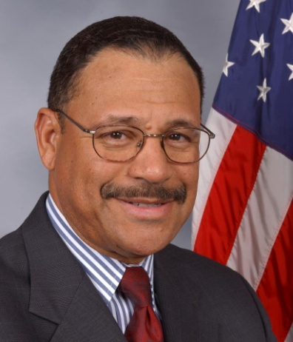
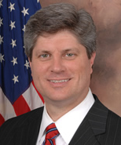
House Appropriations Subcommittee:
Ag, Rural Development, FDA & Related “”
Chair
Ranking Member
Sanford Bishop
D-GA-2nd
Elected 1993
Jeff Fortenberry
R-NE-1st
Elected 2005
Pronunciation: SAN-furd BIH-shuhp
Residence: Albany, GA
Previous Occupation: Attorney
Staff: michael.reed@mail.house.gov, jonathan.halpern@mail.house.gov
Pronunciation: jehf FOR-tuhn-bair-ee
Residence: Lincoln, NE
Previous Occupation: Bus. Dev. Consult.
Staff: alan.feyerherm@mail.house.gov, tom.obrien@mail.house.gov

Slide 17
House Appropriations Subcommittee:
Ag, Rural Development, FDA & Related “”
Majority
Minority
Rep. Sanford Bishop (D-GA)
Rep. Chellie Pingree (D-ME)
Rep. Mark Pocan (D-WI)
Rep. Lauren Underwood (D-IL)
Rep. Barbara Lee (D-CA)
Rep. Betty McCollum (D-MN)
Rep. Debbie Wasserman Schultz (D-FL)
Rep. Henry Cuellar (D-TX)
Rep. Grace Meng (D-NY)
Rep. Rosa DeLauro (D-CT)
Rep. Jeff Fortenberry (R-NE)
Rep. Robert Aderholt (R-AL)
Rep. Andy Harris (R-MD)
Rep. David Valadao (R-CA)
Rep. John Moolenaar (R-MI)
Rep. Dan Newhouse (R-WA)
Rep. Kay Granger (R-TX)

Slide 18
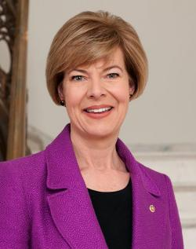
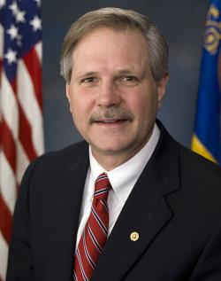
Senate Appropriations Subcommittee:
Ag, Rural Development, FDA & Related “”
Chair
Ranking Member
Tammy Baldwin
D-WI
Elected 2013
John Hoeven
R-ND
Elected 2011
Pronunciation: TA-mee BAHLD-win
Residence: Madison, WI
Previous Occupation: Attorney
Staff: adrienne_wojciechowski@appro. senate.gov, rachel_erlebacher@appro. senate.gov
Pronunciation: jahn HO-vuhn
Residence: Bismarck, ND
Previous Occupation: Banker
Staff: patrick_carroll@appro.senate.gov, elizabeth_dent@appro.senate.gov

Slide 19
Senate Appropriations Subcommittee:
Ag, Rural Development, FDA & Related “”
Majority
Minority
Sen. Tammy Baldwin (D-WI)
Sen. Jeff Merkley (D-OR)
Sen. Dianne Feinstein (D-CA)
Sen. Jon Tester (D-MT)
Sen. Patrick Leahy (D-VT)
Sen. Brian Schatz (D-HI)
Sen. Martin Heinrich (D-NM)
Sen. John Hoeven (R-ND)
Sen. Mitch McConnell (R-KY)
Sen. Susan Collins (R-ME)
Sen. Roy Blunt (R-MO)
Sen. Jerry Moran (R-KS)
Sen. Cindy Hyde-Smith (R-MS)
Sen. Mike Braun (R-IN)

Slide 20
House and Senate Appropriations for
Commerce, Justice, Science & Related “”
Subcommittee jurisdiction for funding includes:
Dept. of Commerce: National Oceanic and Atmospheric Administration (NOAA)
National Aeronautics and Space Administration (NASA)
National Science Foundation (NSF)

Slide 21
Invasive Species Activities in
Commerce, Justice, Science & Related “”
(Commerce) NOAA: $5.4 billion in FY 2021
Operations, Research and Facilities: $3.8 billion
Ocean, Coastal and Great Lakes Research: $231 million
National Sea Grant College Program: $75 million
$3 million increase above the FY 21 enacted level in Sea Grant targeted for research to improve control of invasive lionfish
(Science) NASA: $23.3 billion in FY 2021
Science: $7.3 billion
Earth Science: $2 billion
$10 million increase above the FY 21 enacted level in Earth Science to improve the use of remote sensing as a tool to monitor the distribution of invasive vegetation and predict areas that may be most vulnerable to invasion in the future

Slide 22
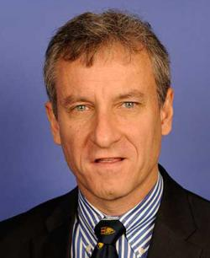
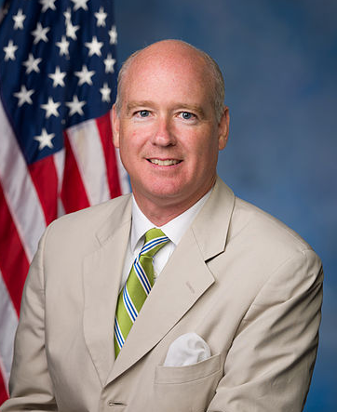
House Appropriations Subcommittee:
Commerce, Justice, Science & Related “”
Chair
Ranking Member
Matt Cartwright
D-PA-17th
Elected 2013
Robert Aderholt
R-AL-4th
Elected 1997
Pronunciation: mat KART-rite
Residence: Moosic, PA
Previous Occupation: Attorney
Staff: jeremy.marcus@mail.house.gov, jeff.ashford@mail.house.gov
Pronunciation: RAH-burt A-dur-holt
Residence: Haleyville, AL
Previous Occupation: Attorney
Staff: mark.dawson@mail.house.gov, stephanie.gadbois@mail.house.gov

Slide 23
House Appropriations Subcommittee:
Commerce, Justice, Science & Related “”
Majority
Minority
Rep. Matt Cartwright (D-PA)
Rep. Grace Meng (D-NY)
Rep. Charlie Crist (D-FL)
Rep. Ed Case (D-HI)
Rep. Dutch Ruppersberger (D-MD)
Rep. Brenda Lawrence (D-MI)
Rep. David Trone (D-MD)
Rep. Rosa DeLauro (D-CT)
Rep. Robert Aderholt (R-AL)
Rep. Steven Palazzo (R-MS)
Rep. Ben Cline (R-VA)
Rep. Mike Garcia (R-CA)
Rep. Kay Granger (R-TX)

Slide 24
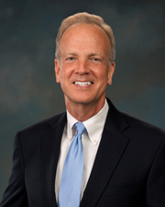
Senate Appropriations Subcommittee:
Commerce, Justice, Science & Related “”
Chair
Ranking Member
Jeanne Shaheen
D-NH
Elected 2009
Jerry Moran
R-KS
Elected 2011
Pronunciation: jeen shuh-HEEN
Residence: Madbury, NH
Previous Occupation: Campaign aide
Staff: jennifer_eskra@appro.senate.gov, elisabeth_coats@appro.senate.gov
Pronunciation: JAIR-ree mor-AN
Residence: Hays, KS
Previous Occupation: Attorney
Staff: matt_womble@appro.senate.gov, allen_cutler@appro.senate.gov

Slide 25
Senate Appropriations Subcommittee:
Commerce, Justice, Science & Related “”
Majority
Minority
Sen. Jeanne Shaheen (D-NH)
Sen. Patrick Leahy (D-VT)
Sen. Dianne Feinstein (D-CA)
Sen. Jack Reed (D-RI)
Sen. Chris Coons (D-DE)
Sen. Brian Schatz (D-HI)
Sen. Joe Manchin (D-WV)
Sen. Chris Van Hollen (D-MD)
Sen. Jeff Merkley (D-OR)
Sen. Jerry Moran (R-KS)
Sen. Lisa Murkowski (R-AK)
Sen. Susan Collins (R-ME)
Sen. Lindsey Graham (R-SC)
Sen. John Boozman (R-AR)
Sen. Shelley Moore Capito (R-WV)
Sen. John Neely Kennedy (R-LA)
Sen. Bill Hagerty (R-TN)
Sen. Mike Braun (R-IN)

Slide 26
House and Senate Appropriations for
Energy and Water Development & Related “”
Subcommittee jurisdiction for funding includes:
US Army Corps of Engineers (ACOE) - Civil
Dept. of the Interior: Bureau of Reclamation (BOR)
BOR: $1.5 billion in FY 2021 for “Water and Related Resources” projects in states.

Slide 27
Invasive Species Activities in
Energy and Water Development & Related “”
ACOE-Civil: $7.8 billion in FY 2021
Construction: $2.7 billion
Aquatic Plant Control Program (APCP): $25 million in FY 2021
$6 million increase above the FY 21 enacted level for nationwide research and development to address invasive aquatic plants
$6 million increase above the FY 21 enacted level to expand boat inspection and decontamination efforts, in tandem with monitoring and rapid response, at Corps-managed reservoirs nationwide, in response to the expanded geographic scope mandated by the Water Resources Development Act (WRDA).

Slide 28
Invasive Species Activities in
Energy and Water Development & Related “”
ACOE-Civil: $7.8 billion in FY 2021
Construction: $2.7 billion
Aquatic Plant Control Program (APCP): $25 million
-After passage of 2020 WRDA, APCP authorized at $200 million per year
Authorizes $130 million for Watercraft Inspection and Decontamination stations in five river basins
Authorizes $50 million for ACOE to enter into partnerships with states and other federal agencies to carry out actions to prevent the introduction of, control, or eradicate invasive species that adversely affect water quantity or water quality in the Platte River Basin, the Upper Colorado River Basin, the Upper Snake River Basin, and the Upper Missouri River Basin with priority given to projects targeting Russian olive or salt cedar trees.

Slide 29
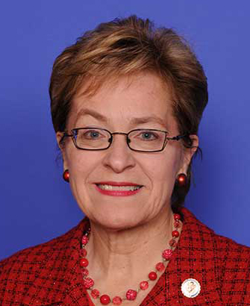
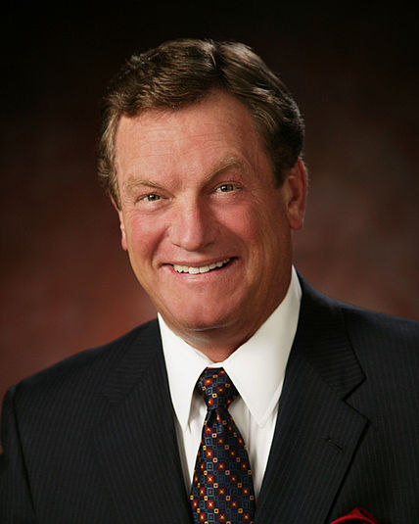
House Appropriations Subcommittee:
Energy and Water Development & Related “”
Chair
Ranking Member
Marcy Kaptur
D-OH-9th
Elected 1983
Mike Simpson
R-ID-2nd
Elected 1999
Pronunciation: MAR-see KAP-tur
Residence: Toledo, OH
Previous Occupation: Urban planner
Staff: jenny.perrino@mail.house.gov, michael.brain@mail.house.gov
Pronunciation: MY-kuhl SIMP-suhn
Residence: Idaho Falls, ID
Previous Occupation: Dentist
Staff: sarah.cannon@mail.house.gov, angie.giancarlo@mail.house.gov

Slide 30
House Appropriations Subcommittee:
Energy and Water Development & Related “”
Majority
Minority
Rep. Marcy Kaptur (D-OH)
Rep. Debbie Wasserman Schultz (D-FL)
Rep. Ann Kirkpatrick (D-AZ)
Rep. Susie Lee (D-NV)
Rep. Tim Ryan (D-OH)
Rep. Derek Kilmer (D-WA)
Rep. Lois Frankel (D-FL)
Rep. Cheri Bustos (D-IL)
Rep. Bonnie Watson Coleman (D-NJ)
Rep. Rosa DeLauro (D-CT)
Rep. Mike Simpson (R-ID)
Rep. Ken Calvert (R-CA)
Rep. Chuck Fleischmann (R-TN)
Rep. Dan Newhouse (R-WA)
Rep. Jaime Herrera Beutler (R-WA)
Rep. Guy Reschenthaler (R-PA)
Rep. Kay Granger (R-TX)

Slide 31
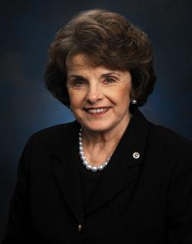
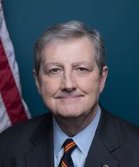
Senate Appropriations Subcommittee:
Energy and Water Development & Related “”
Chair
Ranking Member
Dianne Feinstein
D-CA
Elected 1992
John Neely Kennedy
R-LA
Elected 2017
Pronunciation: die-AN FINE-stine
Residence: San Francisco, CA
Previous Occupation: Public Admin.
Staff: doug_clapp@appro.senate.gov, jen_becker@appro.senate.gov
Pronunciation: jahn KEH-nuh-dee
Residence: Zachary, LA
Previous Occupation: Attorney
Staff: jen_armstrong@appro.senate.gov, meyer_seligman@appro.senate.gov

Slide 32
Senate Appropriations Subcommittee:
Energy and Water Development & Related “”
Majority
Minority
Sen. Dianne Feinstein (D-CA)
Sen. Patty Murray (D-WA)
Sen. Jon Tester (D-MT)
Sen. Dick Durbin (D-IL)
Sen. Jeanne Shaheen (D-NH)
Sen. Jeff Merkley (D-OR)
Sen. Chris Coons (D-DE)
Sen. Tammy Baldwin (D-WI)
Sen. Martin Heinrich (D-NM)
Sen. John Neely Kennedy (R-LA)
Sen. Mitch McConnell (R-KY)
Sen. Richard Shelby (R-AL)
Sen. Susan Collins (R-ME)
Sen. Lisa Murkowski (R-AK)
Sen. Lindsey Graham (R-SC)
Sen. John Hoeven (R-ND)
Sen. Cindy Hyde-Smith (R-MS)
Sen. Bill Hagerty (R-TN)

Slide 33
House and Senate Appropriations for
Interior, Environment & Related Agencies
Subcommittee jurisdiction for funding includes:
Department of the Interior
except Bureau of Reclamation
Environmental Protection Agency
Great Lakes Restoration Initiative (GLRI)
USDA Forest Service

Slide 34
Invasive Species Activities in
Interior, Environment & Related Agencies
EPA- GLRI: $330 million in FY 2021
Fund the Great Lakes Restoration Initiative (GLRI) at the FY 22 authorized level of $375 million.
US Forest Service: $7.4 billion in FY 2021
National Forest System: $1.8 billion
State & Private Forestry: $267.2 million
$6 million increase to the FY 21 enacted level, $3 million each in the National Forest System and State and Private Forestry accounts for a coordinated federal and nonfederal monitoring and treatment effort to reduce the damage posed by invasive insects to the forest ecosystems of the New England and mid-Atlantic states

Slide 35
Invasive Species Activities in
Interior, Environment & Related Agencies
DOI: $13.7 billion in FY 2021
Working Capital Fund: $60.7 million
$500,000 increase above the FY 21 enacted level for the National Invasive Species Council to reinstitute the Invasive Species Advisory Committee, with an emphasis on providing guidance to federal agencies on priorities for research to combat invasive species
Wildland Fire Management: $992.6 million
Fuels Management: $219.9 million
An increase of $20 million above the FY 21 enacted level in Fuels Management to carry out joint projects with the BLM invasive plant management program that accomplish the twin goals of reduced wildland fire risk and reduced distribution of invasive plants

Slide 36
Invasive Species Activities in
Interior, Environment & Related Agencies
BLM: $1.3 billion in FY 2021
Management of Land & Natural Resources: $1.2 billion
Land Resources: $251.4 million
Rangeland: $105.9 million
$10 million increase above the FY 21 enacted level for the management and eradication of the 79 million acres of BLM land infested with noxious and invasive weeds, especially those weeds that pose the greatest threat of wildfire risk or to threatened and endangered species.
FWS: $1.6 billion in FY 2021
Resource Management: $1.4 billion
National Wildlife Refuge System: $503.8 million
Refuge Wildlife and Habitat Management: $239.6 million
$4 million increase above the FY 21 enacted level for the Invasive Species Strike Team (ISST) program that focuses on early detection and rapid response of invasive species

Slide 37
Invasive Species Activities in
Interior, Environment & Related Agencies
NPS: $3.1 billion in FY 2021
Park Management: $2.5 billion
Resource Stewardship: $361.6 million
$2 million increase for NPS to enhance partnerships with states on boat inspection and decontamination for aquatic nuisance species
$4 million increase for the Invasive Plant Management Teams program
USGS: $1.3 billion in FY 2021
Ecosystems: $259.1 million
Biological Threats & Invasives Spp. Research: $38.2 million
$10 million increase to coordinate the activities of all DOI bureaus to more effectively standardize invasive species data and contribute data to the Invasive Species Data Mobilization program of the Western Governors Association and other similar regional data coordination efforts nationwide

Slide 38
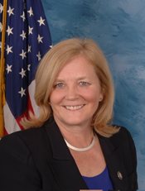
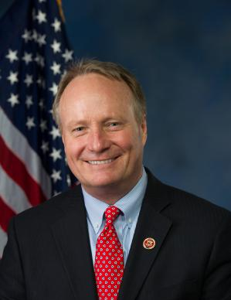
House Appropriations Subcommittee:
Interior, Environment & Related “”
Chair
Ranking Member
Chellie Pingree
D-ME-1st
Elected 2009
David Joyce
R-OH-14th
Elected 2013
Pronunciation: SHEH-lee PING-gree
Residence: North Haven, ME
Previous Occupation: Organic farmer
Staff: peter.kiefhaber@mail.house.gov, jocelyn.hunn@mail.house.gov
Pronunciation: DAY-vid joyss
Residence: Russell Township, OH
Previous Occupation: Attorney
Staff: chris.cooper@mail.house.gov, darren.benjamin@mail.house.gov

Slide 39
House Appropriations Subcommittee:
Interior, Environment & Related “”
Majority
Minority
Rep. Chellie Pingree (D-ME)
Rep. Betty McCollum (D-MN)
Rep. Derek Kilmer (D-WA)
Rep. Josh Harder (D-CA)
Rep. Susie Lee (D-NV)
Rep. Marcy Kaptur (D-OH)
Rep. Matt Cartwright (D-PA)
Rep. Rosa DeLauro (D-CT)
Rep. Dave Joyce (R-OH)
Rep. Mike Simpson (R-ID)
Rep. Chris Stewart (R-UT)
Rep. Mark Amodei (R-NV)
Rep. Kay Granger (R-TX)

Slide 40
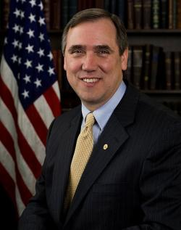
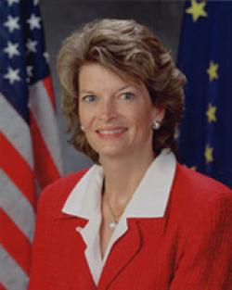
Senate Appropriations Subcommittee:
Interior, Environment & Related “”
Chair
Ranking Member
Jeff Merkley
D-OR
Elected 2009
Lisa Murkowski
R-AK
Elected 2002
Pronunciation: jehf MURK-lee
Residence: Portland, OR
Previous Occupation: Non-profit exec.
Staff: ryan_hunt@appro.senate.gov, anthony_sedillo@appro.senate.gov
Pronunciation: LEE-suh mur-KOU-skee
Residence: Anchorage, AK
Previous Occupation: Attorney
Staff: nona_mccoy@appro.senate.gov; lucas_agnew@appro.senate.gov

Slide 41
Senate Appropriations Subcommittee:
Interior, Environment & Related “”
Majority
Minority
Sen. Jeff Merkley (D-OR)
Sen. Dianne Feinstein (D-CA)
Sen. Patrick Leahy (D-VT)
Sen. Jack Reed (D-RI)
Sen. Jon Tester (D-MT)
Sen. Chris Van Hollen (D-MD)
Sen. Martin Heinrich (D-NM)
Sen. Lisa Murkowski (R-AK)
Sen. Roy Blunt (R-MO)
Sen. Mitch McConnell (R-KY)
Sen. Shelley Moore Capito (R-WV)
Sen. Cindy Hyde-Smith (R-MS)
Sen. Bill Hagerty (R-TN)
Sen. Marco Rubio (R-FL)

Slide 42
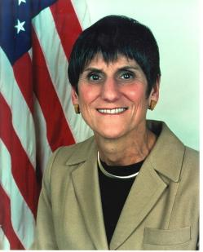
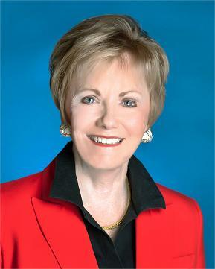
House Appropriations Committee
Chair
Ranking Member
Rosa DeLauro
D-CT
Elected 1991
Kay Granger
R-TX
Elected 1997
Pronunciation: RO-suh deh-LOOR-o
Residence: New Haven, CT
Previous Occupation: Non-profit Coord.
Staff: christian.lovell@mail.house.gov
Pronunciation: kay GRAIN-jur
Residence: Fort Worth, TX
Previous Occupation: Teacher & Insurance
Staff: heather.campbell@mail.house.gov

Slide 43
House Appropriations Committee
Majority
Majority
Minority
Rep. Rosa DeLauro (D-CT)
Rep. Marcy Kaptur (D-OH)
Rep. David Price (D-NC)
Rep. Lucille Roybal-Allard (D-CA)
Rep. Sanford Bishop (D-GA)
Rep. Barbara Lee (D-CA)
Rep. Betty McCollum (D-MN)
Rep. Tim Ryan (D-OH)
Rep. Dutch Ruppersberger (D-MD)
Rep. Deb Wasserman Schultz D-FL)
Rep. Henry Cuellar (D-TX)
Rep. Chellie Pingree (D-ME)
Rep. Mike Quigley (D-IL)
Rep. Derek Kilmer (D-WA)
Rep. Matt Cartwright (D-PA)
Rep. Grace Meng (D-NY)
Rep. Mark Pocan (D-WI)
Rep. Katherine Clark (D-MA)
Rep. Pete Aguilar (D-CA)
Rep. Lois Frankel (D-FL)
Rep. Cheri Bustos (D-IL)
Rep. Bonnie Watson Coleman (D-NJ)
Rep. Brenda Lawrence (D-MI)
Rep. Norma Torres (D-CA)
Rep. Charlie Crist (D-FL)
Rep. Ann Kirkpatrick (D-AZ)
Rep. Ed Case (D-HI)
Rep. Adriano Espaillat (D-NY)
Rep. Josh Harder (D-CA)
Rep. Jennifer Wexton (D-VA)
Rep. David Trone (D-MD)
Rep. Lauren Underwood (D-IL)
Rep. Susie Lee (D-NV)
Rep. Kay Granger (R-TX)
Rep. Hal Rogers (R-KY)
Rep. Robert Aderholt (R-AL)
Rep. Mike Simpson (R-ID)
Rep. John Carter (R-TX)
Rep. Ken Calvert (R-CA)
Rep. Tom Cole (R-OK)
Rep. Mario Diaz-Balart (R-FL)
Rep. Steve Womack (R-AR)
Rep. Jeff Fortenberry (R-NE)
Rep. Chuck Fleischmann (R-TN)
Rep. Jaime Herrera Beutler (R-WA)
Rep. Dave Joyce (R-OH)
Rep. Andy Harris (R-MD)
Rep. Mark Amodei (R-NV)
Rep. Chris Stewart (R-UT)
Rep. Steven Palazzo (R-MS)
Rep. David Valadao (R-CA)
Rep. Dan Newhouse (R-WA)
Rep. John Moolenaar (R-MI)
Rep. John Rutherford (R-FL)
Rep. Ben Cline (R-VA)
Rep. Guy Reschenthaler (R-PA)
Rep. Mike Garcia (R-CA)
Rep. Ashley Hinson (R-IA)
Rep. Tony Gonzales (R-TX)

Slide 44
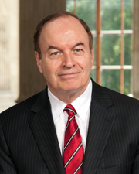
Senate Appropriations Committee
Chair
Ranking Member
Patrick Leahy
D-VT
Elected 1975
Richard Shelby
R-AL
Elected 1987
Pronunciation: PA-trik LAY-hee
Residence: Middlesex, VT
Previous Occupation: Attorney
Staff: andrew_bahrenburg@leahy.
senate.gov
Pronunciation: RIH-churd SHELL-bee
Residence: Tuscaloosa, AL
Previous Occupation: Prosecutor
Staff: will_brewster@shelby.senate.gov

Slide 45
Senate Appropriations Committee
Majority
Minority
Sen. Patrick Leahy (D-VT)
Sen. Patty Murray (D-WA)
Sen. Dianne Feinstein (D-CA)
Sen. Dick Durbin (D-IL)
Sen. Jack Reed (D-RI)
Sen. Jon Tester (D-MT)
Sen. Jeanne Shaheen (D-NH)
Sen. Jeff Merkley (D-OR)
Sen. Chris Coons (D-DE)
Sen. Brian Schatz (D-HI)
Sen. Tammy Baldwin (D-WI)
Sen. Chris Murphy (D-CT)
Sen. Joe Manchin (D-WV)
Sen. Chris Van Hollen (D-MD)
Sen. Martin Heinrich (D-NM)
Sen. Richard Shelby (R-AL)
Sen. Mitch McConnell (R-KY)
Sen. Susan Collins (R-ME)
Sen. Lisa Murkowski (R-AK)
Sen. Lindsey Graham (R-SC)
Sen. Roy Blunt (R-MO)
Sen. Jerry Moran (R-KS)
Sen. John Hoeven (R-ND)
Sen. John Boozman (R-AR)
Sen. Shelley Moore Capito (R-WV)
Sen. John Neely Kennedy (R-LA)
Sen. Cindy Hyde-Smith (R-MS)
Sen. Mike Braun (R-IN)
Sen. Bill Hagerty (R-TN)
Sen. Marco Rubio (R-FL)

Slide 46
Outline
Show Me the Money? Review of Federal Agency spending on invasive species activities
117th Congress: House and Senate Appropriations Committees that fund invasive species activities
Jurisdiction, Leaders, and Members
Agriculture, Rural Development, FDA & Related ““
Commerce, Justice, and Science (CJS) & Related “”
Energy and Water Development, & Related “”
Interior, Environment & Related Agencies
Some Advocacy Tips

Slide 47
Virtual Meetings are the New Norm
Do your homework: www.congress.gov
Try to schedule a week or two in advance
Always introduce yourself
Be concise- try to stick to 3 main points
Use personal stories if possible
Be honest. If you don’t know, don’t make it up!
Follow up with a thank you and any requested info

Slide 48
Invasives Species Spending by Federal Land Management Agencies
 | Acres | Spending | $/Acre
 | ------- millions ------
Dept. of Defense | 8.8 | $140 | $15.91
USDA- Forest Service | 192.9 | $1,334 | $6.92
Dept. of the Interior | 413.5 | $107 | $0.26
Fish and Wildlife Service | 89.2 | $35 | $0.39
National Park Service | 79.9 | $20 | $0.25
Bureau of Land Management | 244.4 | $15 | $0.06

Slide 49
Thank You!
Lee Van Wychen
Lee.VanWychen@wssa.net
Cell: 202-746-4686
Southern Weed Science Society
North Central
Weed Science Society

